Slide 1
Effective mass of the EDF
Constrained to be around 0.7 m in SLyX EDF’s
Very low in RMF Lagrangians (around 0.6m)
An increase of the effective masse -> more dense spectrum
(based on Mahaux et al. in the 80’s , correlations increase the effective mass)
Pure WS -> effective mass = nucleon mass
(not the case in Chasman WS!)

Slide 2
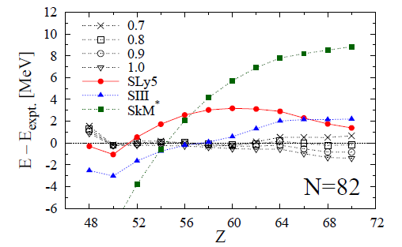
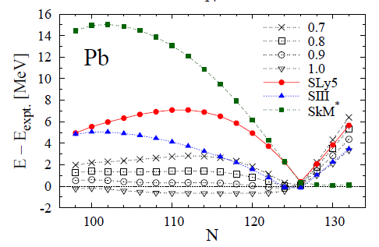

Slide 3
Caution!
The effect of the effective can be drawn without ambiguity only
for parameterizations that have been adjusted in the same way.
SLIII family : improvement of SIII by a fitting protocol similar to the Sly’s
- with inclusion of deformation properties of selected nuclei
- an exponent for the density dependence equal to 1
(to avoid some problems in beyond mean-field calculations
alpha = 1 -> compressibility of infinite nuclear matter cannot be right
effective mass can be varied (K and m* strongly linked)

Slide 4
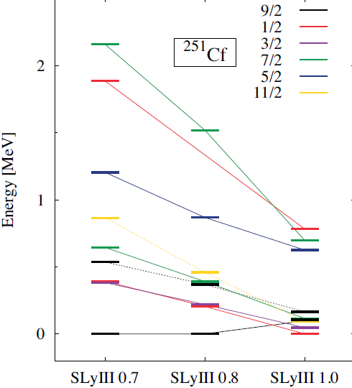
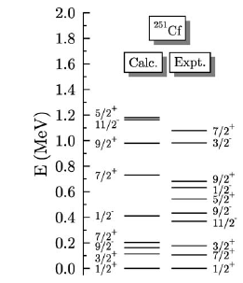

Slide 5
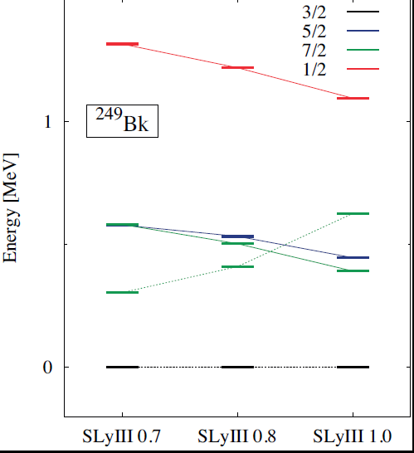
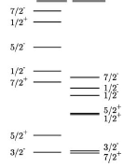

Slide 6
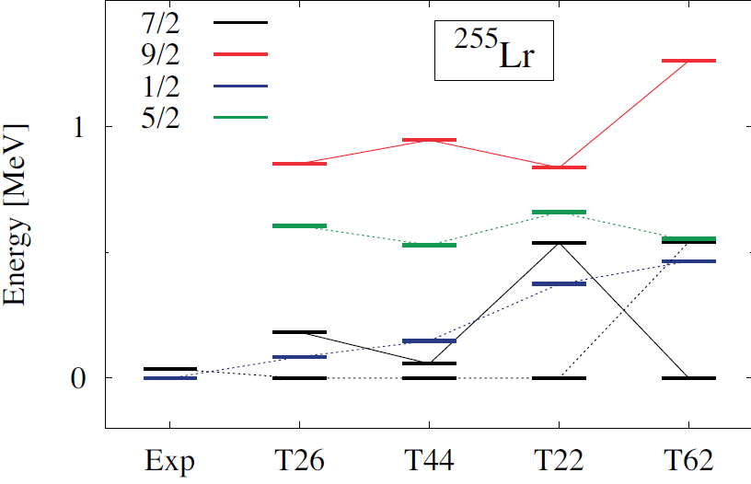
Has a tensor term in the EDF an effect on spectra?

Slide 7
Old questions with sometimes old answers…
To be revisited but not forgotten
Equivalence RPA-GCM: partial answers in
Jancovici and Schiff (NPA 58 (1964) 678)
Brink and Weiguny (NPA 120 (1968) 59)
RPA-TDHF and correlations in the RPA ground state

Slide 8
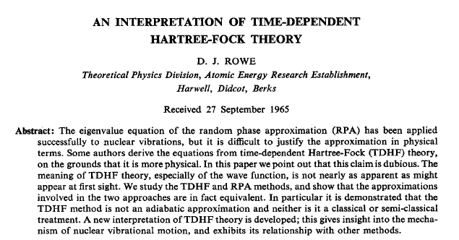

Slide 9
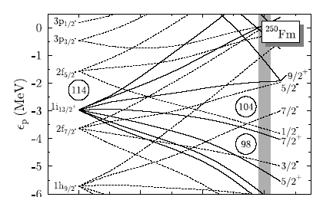


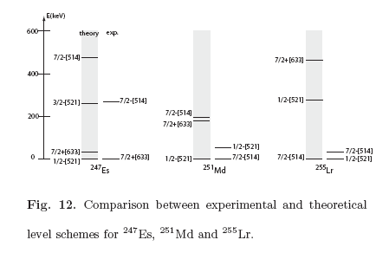
Z = 99, 101, 103

Slide 10
Careful analysis of RMF results leads to similar conclusions:
some orbitals are not placed as they should to reproduce
experimental spectra with an accuracy better than 500 keV
The lowering of n j_{15/2} and p i _{13/2} can be done by increased
spin orbit but not consistent with other analyses.
Changes pf spherical gaps would change the deformed Z=110
and Z=108 deformed gaps. Probably not much effects on Z=114

Slide 11
Conclusions
Full HFB calculations can be systematically done for SHE nuclei
Global properties (deformation, α decay energies, …) correctly described
Beyond mean-field methods should be applicable in a few years
(projection, configuration mixing): particle-vibration coupling
The tool needed to improve the description of 1qp (and 2qp!) states has still
to be found.

