Slide 1
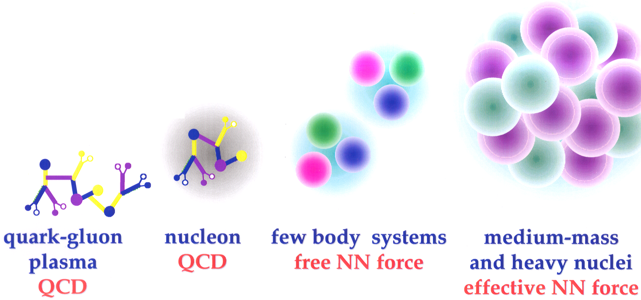
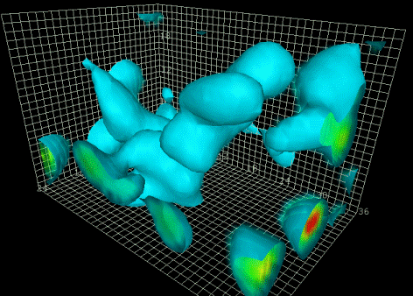
3D angular momentum and isospin restored calculations
with the Skyrme EDF
Wojciech Satuła
in collaboration with J. Dobaczewski, W. Nazarewicz & M. Rafalski
Intro: → define fundaments my model is „standing on”
sp mean-field (or nuclear DFT) ➔ beyond mean-field (projection after variation)
Symmetry (isospin) violation and restoration:
unphysical symmetry violation → isospin projection
Coulomb rediagonalization (explicit symmetry violation)
Results
isospin impurities in ground-states of e-e nuclei
structural effects → SD bands in ⁵⁶Ni
ISB corrections to superallowed beta decay
Summary
ab initio
+ NNN + ....
tens of MeV

Slide 2
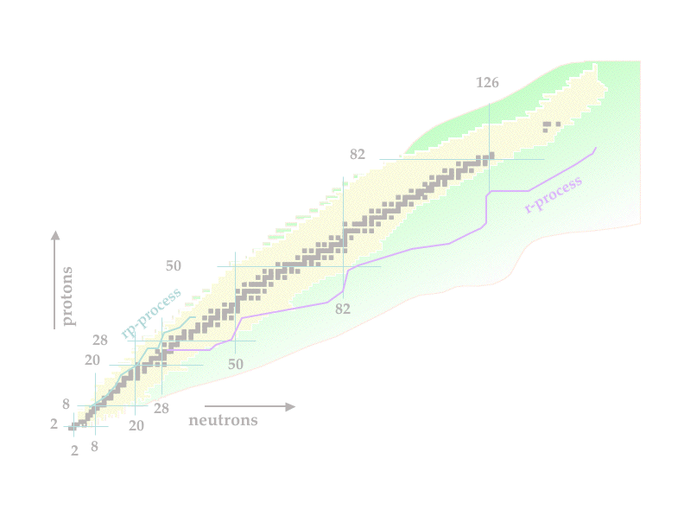
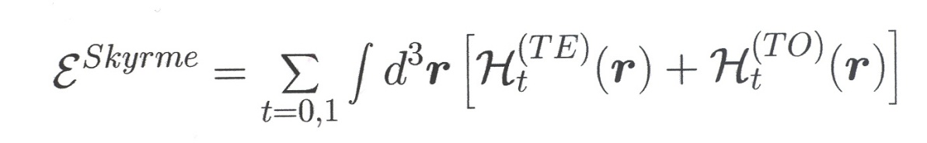
Skyrme-force-inspired local energy density functional
(without pairing)
Ψ | v(1,2) | Ψ
average Skyrme interaction
(in fact a functional!) over
the Slater determinant
local energy density functional
SV is the only Skyrme interaction
Beiner et al. NPA238, 29 (1975)
Skyrme (nuclear) interaction conserves:
→ rotational (spherical) symmetry
→ isospin symmetry: V_{nn} = V_{pp} = V_{np} (in reality approximate)
LS
LS
LS
Mean-field solutions (Slater determinants)
break (spontaneously) these symmetries
Symmetry-conserving
configurtion
Total energy (a.u.)
Symmetry-breaking
configurations
Deformation (q)

Slide 3

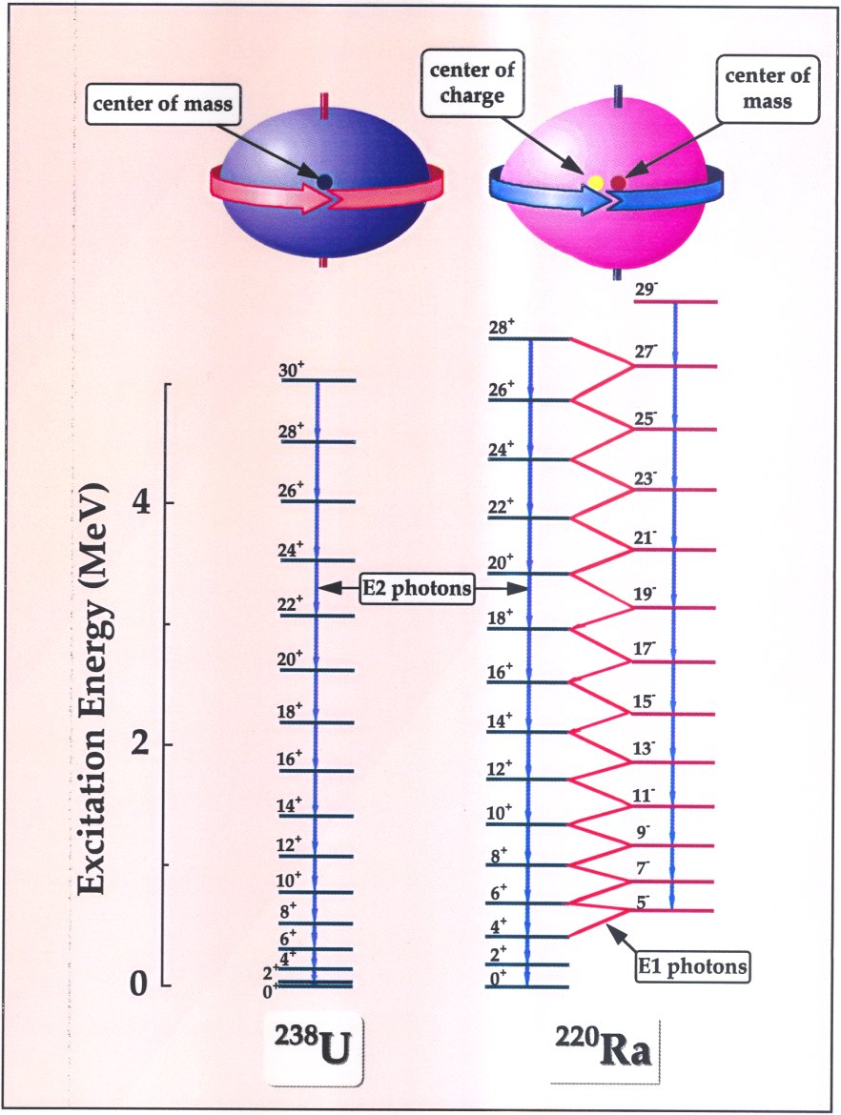


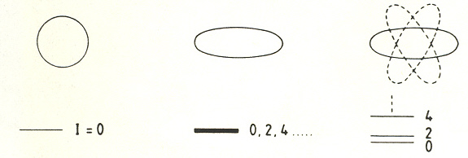

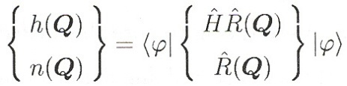
Restoration of broken symmetry
Beyond mean-field → multi-reference density functional theory
rotated Slater
determinants
are equivalent
solutions
Euler angles
in space or/and isospace
gauge angle
where

Slide 4
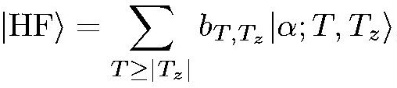
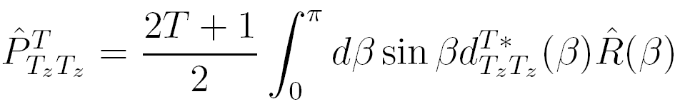
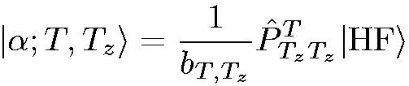
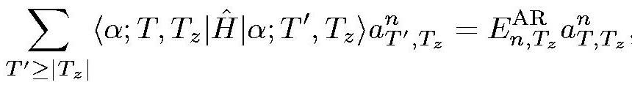
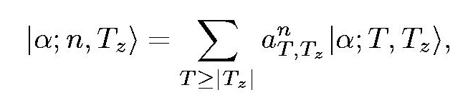
Isospin symmetry restoration
There are two sources of the isospin symmetry breaking:
unphysical, caused solely by the HF approximation
physical, caused mostly by Coulomb interaction
(also, but to much lesser extent, by the strong force isospin non-invariance)
Engelbrecht & Lemmer,
PRL24, (1970) 607
Find self-consistent HF solution (including Coulomb) → deformed
Slater determinant |HF>:
See: Caurier, Poves & Zucker,
PL 96B, (1980) 11; 15
BR
Apply the isospin projector:
α_{C} = 1 - |b_{T=|Tz|}|²
in order to create good isospin
„basis”:
Diagonalize total Hamiltonian in
„good isospin basis” |α,T,T_{z}>
→ takes physical isospin mixing
AR
n=1
α_{C} = 1 - |a_{T=Tz}|²

Slide 5
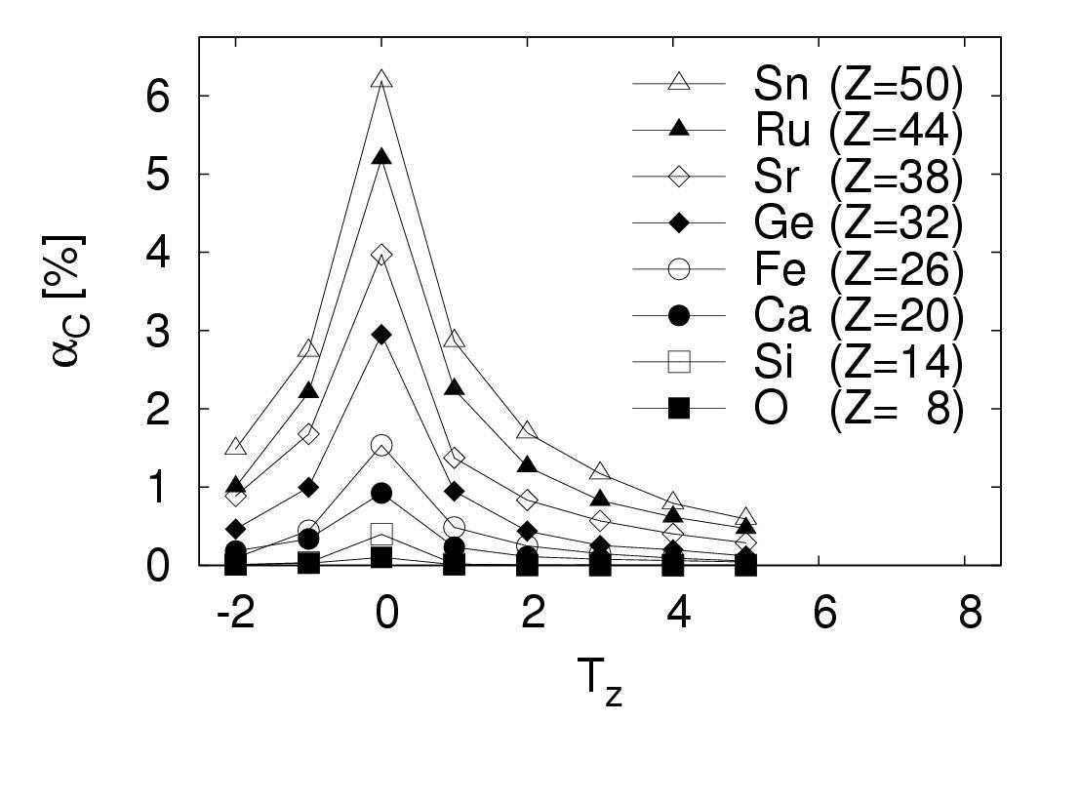
Numerical results:
Isospin impurities in ground states of e-e nuclei
W.Satuła, J.Dobaczewski, W.Nazarewicz, M.Rafalski, PRL103 (2009) 012502
Ca isotopes:
Here the HF is solved
without Coulomb
|HF;e_{MF}=0>.
0.4
SLy4
BR
AR
0.2
e_{MF} = 0
0
α_{C} [%]
1
1.0
0.1
0.8
0.01
Here the HF is solved
with Coulomb
|HF;e_{MF}=e>.
0.6
40
44
48
52
56
60
0.4
e_{MF} = e
0.2
0
In both cases rediagonalization
is performed for the total
Hamiltonian including
Coulomb
40
44
48
52
56
60
Mass number A

Slide 6
(II) Isospin mixing & energy in the ground states of
e-e N=Z nuclei:
HF tries to reduce the
isospin mixing by:
6
N=Z nuclei
Δα_{C}
~30%
5
AR
in order to minimize
the total energy
4
α_{C} [%]
3
BR
2
1
SLy4
Projection increases the
ground state energy
(the Coulomb and symmetry
energies are repulsive)
0
BR
1.0
AR
BR
0.8
0.6
E-E_{HF} [MeV]
0.4
Rediagonalization (GCM)
0.2
AR
0
lowers the ground state
energy but only slightly
below the HF
20
28
36
44
52
60
68
76
84
92
100
A
This is not a single Slater determinat
There are no constraints on mixing coefficients

Slide 7
Excitation energy of the T=1 doorway state in N=Z nuclei
Bohr, Damgard & Mottelson
hydrodynamical estimate
ΔE ~ 169/A^{1/3} MeV
35
mean
values
30
E(T=1)-E_{HF} [MeV]
Sliv & Khartionov PL16 (1965) 176
25
Δl=0, Δn_{r}=1 → ΔN=2
ΔE ~ 2hω ~ 82/A^{1/3} MeV
SIII
based on perturbation theory
20
SLy4
SkP
20
40
60
80
100
7
SkP
¹⁰⁰Sn
A
SLy5
SLy
SkP
6
MSk1
SLy4
SkM*
α_{C} [%]
SIII
5
SkO’
SkXc
SkO
4
y = 24.193 – 0.54926x R= 0.91273
31.5
32.0
32.5
33.0
33.5
34.0
34.5
doorway state energy [MeV]

Slide 8
Spontaneous isospin mixing in N=Z nuclei in
other but isoscalar configs
→ yet another strong motivation for isospin projection ←
Mean-field
four-fold degeneracy of the sp levels
ν
ν
π
π
ν
ν
π
π
ν
π
or
ν
π
ν
π
or
ν
π
aligned configuration
anti-aligned configuration
Isospin projection
T=1
ν
π
T=0
ν
π
T=0

Slide 9
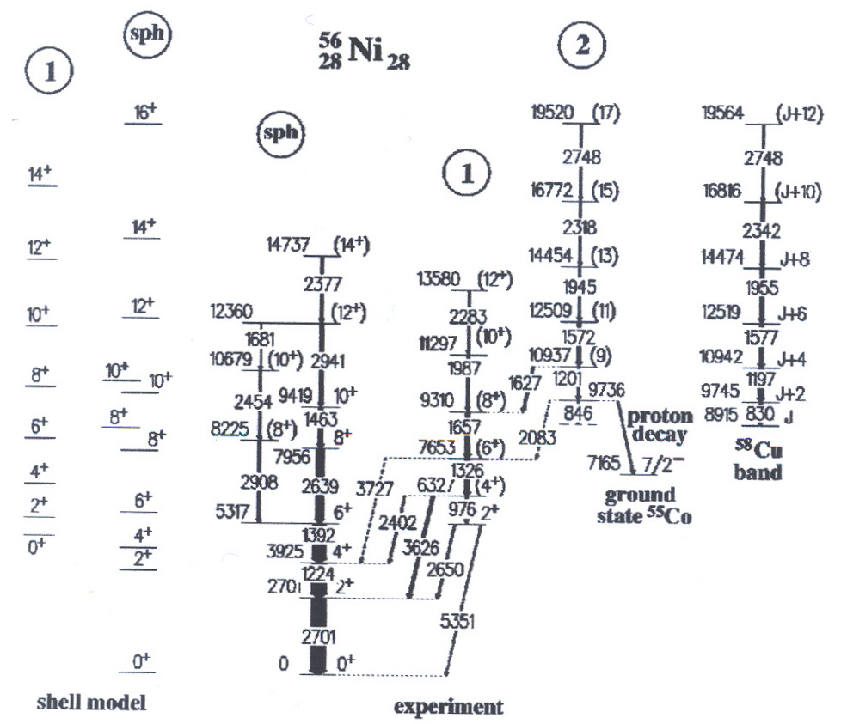
Isospin symmetry violation in
superdeformed bands in ⁵⁶Ni
1
4p-4h
f_{5/2}
Nilsson
p_{3/2}
[321]1/2
f_{7/2}
[303]7/2
neutrons
protons
space-spin symmetric
2
g_{9/2}
f_{5/2}
π_{p-h}
p_{3/2}
f_{7/2}
neutrons
protons
D. Rudolph et al. PRL82, 3763 (1999)
two isospin asymmetric
degenerate solutions

Slide 10
Mean-field
Isospin
projection
T=1
ν_{ph}
δΕ_{Τ}
centroid
π_{ph}
δΕ_{Τ}
8
band 2
α_{C} [%]
6
T=0
4
band 1
2
20
Hartree-Fock
Isospin-projection
16
⁵⁶Ni
Excitation energy [MeV]
12
8
Exp. band 1
Exp. band 2
Th. band 1
Th. band 2
4
5
10
15
5
10
15
Angular momentum
Angular momentum
W.Satuła, J.Dobaczewski, W.Nazarewicz, M.Rafalski, PRC81 (2010) 054310

Slide 11


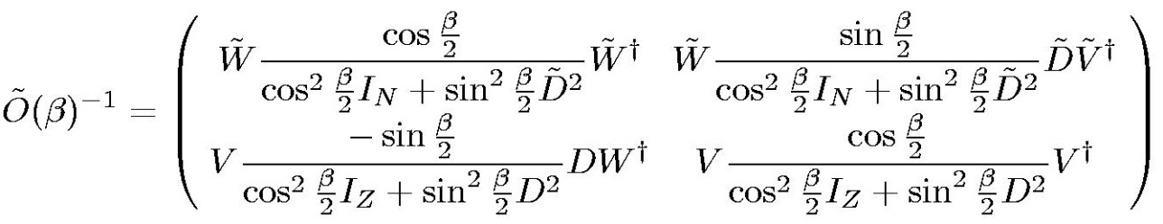
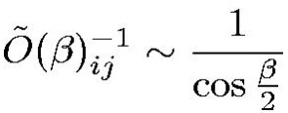


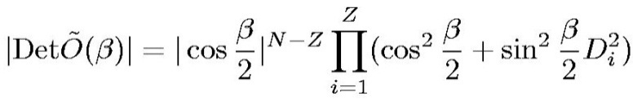
Isospin-projection is non-singular:
SVD eigenvalues
(diagonal matrix)
W.Satuła, J.Dobaczewski, W.Nazarewicz, M.Rafalski, PRC81 (2010) 054310
SVD
singularity
(if any) at β=π
is inherited by ρ
ρ =Σ ψ_{i}* O_{ij} ϕ_{j}
~
-1
ij
in the worst case
η > 3
1 + |N-Z| - η + |N-Z|+2k
k is a multiplicity of
zero singular values

Slide 12
⁴²Sc – isospin projection from [K,-K]
configurations with K=1/2,…,7/2
isospin &
angular momentum
40
isospin
30
α_{C} [%]
20
10
0.586(2)%
0
1
3
5
7
2K
Isospin and angular-momentum projected DFT is ill-defined
except for the hamiltonian-driven functionals
there is no alternative but Skyrme SV

Slide 13
Why we have to to use Skyrme-V?
1
0.1
|OVERLAP|
only IP
0.01
0.001
IP+AMP
0.0001
π
0.0
0.5
1.0
1.5
2.0
2.5
3.0
ρ =Σ ψ_{i}* O_{ij} ϕ_{j}
β_{T} [rad]
T
-1
ij
HF sp state
space & isospin rotated
sp state
inverse of the
overlap matrix

Slide 14
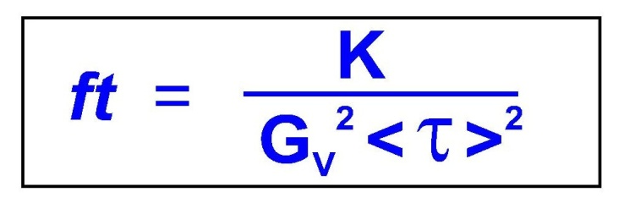
Primary motivation of the project → isospin corrections
for superallowed beta decay
T_{z}=-/+1
J=0⁺,T=1
(N-Z=-/+2)
t_{1/2}
τ_{+/-}
Q_{β}
BR
J=0⁺,T=1
T_{z}=0
(N-Z=0)
d_{5/2}
Experiment:
Fermi beta decay:
8
8
|<τ_{+/−}>|²=2(1-δ_{C})
p_{1/2}
p_{3/2}
f → statistical rate function f (Z,Q_{β})
2
2
s_{1/2}
t → partial half-life f (t_{1/2},BR)
p
n
p
n
G_{V}→ vector (Fermi) coupling constant
¹⁴N
<τ_{+/−}>→ Fermi (vector) matrix element
¹⁴O
10 cases measured with accuracy ft ~0.1%
Hartree-Fock
3 cases measured with accuracy ft ~0.3%

Slide 15
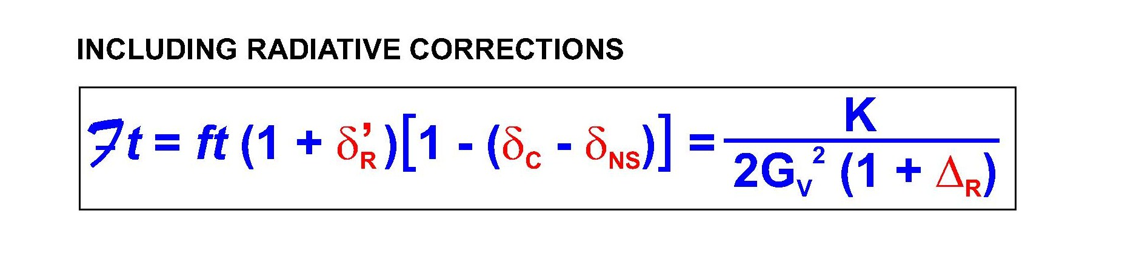
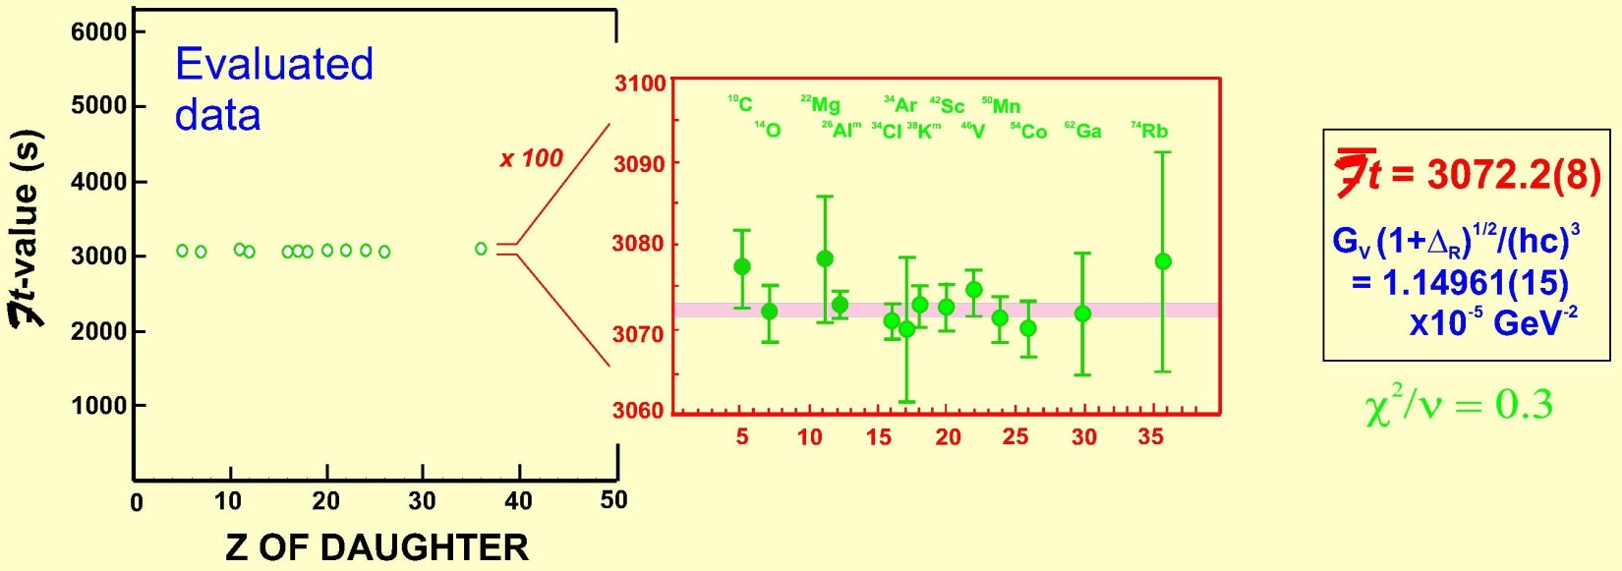
NS-independent
γ
e
nucleus-independent
ν
~1.5%
0.3% - 2.0%
~2.4%
NS-dependent
Towner,
NPA540, 478 (1992)
PLB333, 13 (1994)
Marciano & Sirlin,
PRL96, 032002, (2006)
γ
e
The 13 precisely known transitions, after including
theoretical corrections, are used to
ν
test the CVC hypothesis
Towner & Hardy
Phys. Rev. C77, 025501 (2008)
courtesy of J.Hardy

Slide 16

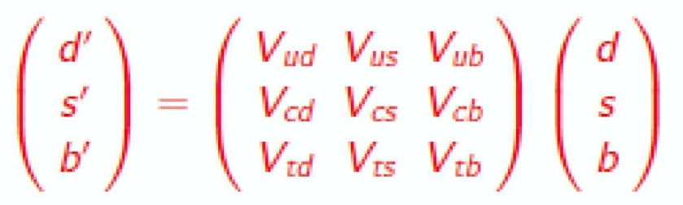
With the CVC being verified and knowing G_{μ} (muon decay)
one can determine
mass eigenstates
CKM
Cabibbo-Kobayashi-Maskawa
weak eigenstates
|V_{ud}| ⁼ 0.97425 + 0.00023
→ test unitarity of the CKM matrix
|V_{ud}|²+|V_{us}|²+|V_{ub}|²=0.9996(7)
0.9491(4)
0.0504(6)
<0.0001
test of three generation quark Standard Model of electroweak interactions

Slide 17
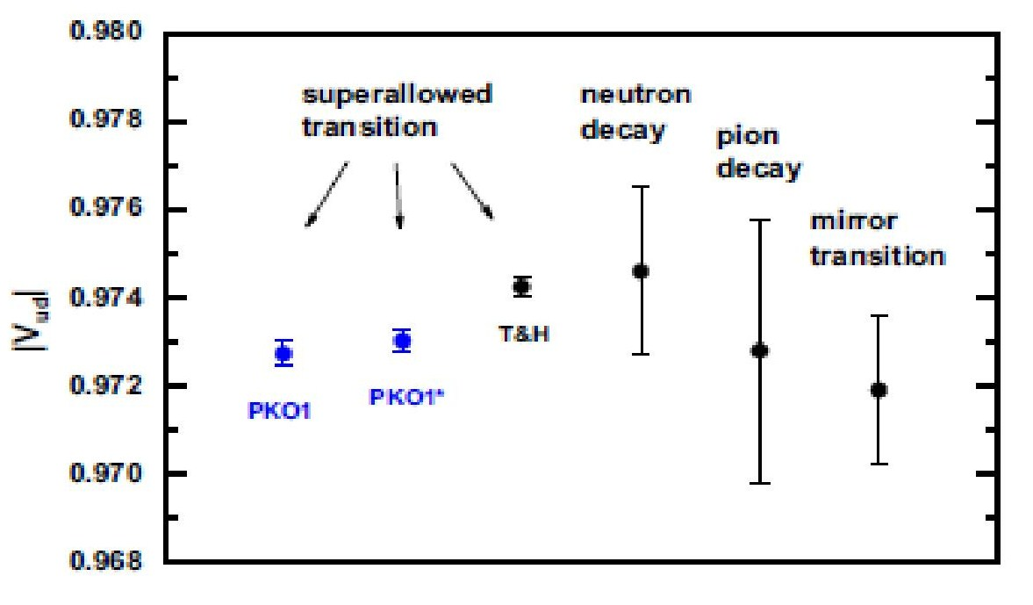
„Hidden” model dependence
Towner & Hardy
Phys. Rev. C77, 025501 (2008)
Liang & Giai & Meng
Phys. Rev. C79, 064316 (2009)
δ_{C}=δ_{C2}+δ_{C1}
spherical RPA
Coulomb exchange treated in the
Slater approxiamtion
mean
field
shell
model
radial mismatch of the wave functions
configuration
mixing
Miller & Schwenk
Phys. Rev. C78 (2008) 035501;C80 (2009) 064319

Slide 18
Isobaric symmetry violation
in o-o N=Z nuclei
T_{z}=-/+1
J=0⁺,T=1
(N-Z=-/+2)
t_{1/2}
τ_{+/-}
Q_{β}
BR
J=0⁺,T=1
T_{z}=0
(N-Z=0)
MEAN FIELD
ν
ν
π
π
ν
ν
π
π
CORE
CORE
aligned configurations
anti-aligned configurations
ν
π
or
ν
π
ν
π
or
ν
π
ISOSPIN PROJECTION
T=1
ν
π
T=0
ν
π
T=0
Mean-field can differentiate between
ground state
is beyond mean-field!
ν
π
and
ν
π
only through time-odd polarizations!

Slide 19
Hartree-Fock
ground state
in N-Z=+/-2 (e-e) nucleus
CPU
antialigned state
in N=Z (o-o) nucleus
~ few h
Project on good isospin (T=1) and angular momentum (I=0)
(and perform Coulomb rediagonalization)
Project on good isospin (T=1) and angular momentum (I=0)
(and perform Coulomb rediagonalization)
~ few years
τ_{+/-}
<T~1,T_{z}=+/-1,I=0|
|I=0,T~1,T_{z}=0>
~
~
H&T → δ_{C}=0.330%
¹⁴O
¹⁴N
L&G&M → δ_{C}=0.181%
our: → δ_{C}=0.303% (Skyrme-V; N=12)

Slide 20
1.4
T_{z}= 1 T_{z}=0
H&T:
1.2
Ft=3071.4(8)+0.85(85)
1.0
V_{ud}=0.97418(26)
0.8
our (no A=38):
δ_{C} [%]
0.6
Ft=3070.4(9)
0.4
V_{ud}=0.97447(23)
0.2
|V_{ud}|²+|V_{us}|²+|V_{ub}|²=
=1.00031(61)
0
A
10
14
18
22
26
30
34
38
42
2.0
T_{z}=0 T_{z}=1
1.5
δ_{C} [%]
1.0
0.5
W.Satuła, J.Dobaczewski,
W.Nazarewicz, M.Rafalski,
PRL106 (2011) 132502
0
A
26
34
42
50
58
66
74

Slide 21
0.976
0.975
H&T’08
0.974
our
model
|V_{ud}|
0.973
Liang et al.
ν-decay
0.972
0.971
superallowed β-decay
0.970
T=1/2 mirror
β-transitions
π⁺-decay

Slide 22
Confidence level test based on the CVC hypothesis
Towner & Hardy, PRC82, 065501 (2010)
2.5
(SV)
Ft
δ_{C}
(EXP)
δ_{C} = 1+δ_{NS} -
‚
(EXP)
ft(1+δ_{R})
2.0
δ_{C}
1.5
Minimize RMS deviation
between the caluclated
and experimental δ_{C} with
respect to Ft
δ_{C} [%]
1.0
0.5
χ²/n_{d}=5.2
for Ft = 3070.0s
75% contribution to the
χ² comes from A=62
0
0
5
10
15
20
25
30
35
40
Z of daughter

Slide 23
SUMMARY OF THE CALCULATIONS
N_{cutoff}=10
N_{cutoff}=12
2.5
T_{z} → T_{z}+1
A=58
2.0
A=38
1.5
δ_{C} [%]
1.0
A=18
0.5
T_{z} = -1
T_{z} = 0
0
0
10
20
30
40
50
60
70
80
A

Slide 24
Summary
Elementary excitations in binary systems may differ
from simple particle-hole (quasi-particle) exciatations
especially when interaction among particles posseses
additional symmetry (like the isospin symmetry in nuclei)
Projection techniques seem to be necessary to account
for those excitations - how to construct non-singular EDFs?
[Isospin projection, unlike the angular-momentum and particle-number
projections, is practically non-singular !!!]
Superallowed 0⁺→0⁺beta decay:
→ encomaps extremely rich physics: CVC, V_{ud},
unitarity of the CKM matrix, scalar currents…
connecting nuclear and particle physics
→ … there is still something to do
in δ_{c} business …
Pairing & other (shape vibrations) correlations can be
„realtively easily” incorporated into the scheme by
combining projection(s) with GCM

Slide 25
„NEW OPPORTUNITIES” IN STUDIES OF THE SYMMETRY ENERGY:
T=1
ν
π
1
a’_{sym}
E’_{sym} = a’_{sym}T(T+1)
T=0
2
In infinite nuclear
matter we have:
SLy4
6
SLy4_{L}
SkM_{L}*
SLy4:
SV
a_{sym}=32.0MeV
4
SV:
a’_{sym} [MeV]
a_{sym}=32.8MeV
2
SkM*:
a_{sym}=30.0MeV
m
0
a_{sym}= e_{F} + a_{int}
m*
10
20
30
40
50
SLy4: 14.4MeV
SV: 1.4MeV
SkM*: 14.4MeV
A (N=Z)

